Slide 1
WHAT REALLY DECIDES
A GRAND PRIX?
23CSE351 · FOUNDATIONS OF DATA SCIENCE · CASE STUDY
A statistical and predictive study of 75 years of Formula 1, 1950–2025
Team member | Register number
R. Meghapranay | CB.SC.U4CSE24440
P. Krishna Chaitanaya | CB.SC.U4CSES24436
M. Rishit Kumar | CB.SC.U4CSE24428
K. Aditya | CB.SC.U4CSE24423
Department of Computer Science and Engineering
Notes:
Introduce the team and the question. We analysed every Formula 1 World Championship race from 1950 to 2025 to test what really decides a Grand Prix: the car, the driver, qualifying, the circuit or the era. The study covers data preprocessing, exploratory analysis, 13 hypothesis tests including three A/B tests, and a regression model that predicts finishing position.

Slide 2
TESTING F1'S BIGGEST BELIEFS WITH DATA
PROBLEM STATEMENT AND OBJECTIVES
Teams spend up to the US$135M budget cap on decisions built on beliefs such as "the race is won in qualifying", "the car matters more than the driver" and "home crowds lift drivers".
01
02
Understand what drives race outcomes: grid, car, driver, circuit, era
Test popular beliefs with hypothesis tests, p-values and effect sizes
The FIA rewrites the rules to create closer racing and less dominance, but rarely measures whether the changes worked.
We test these beliefs on every race from 1950 to 2025, and predict results from pre-race information.
03
04
Evaluate policy with A/B tests of the 2014 and 2022 regulations
Predict finishing position with a validated regression model
Notes:
Formula 1 is a multi-billion-dollar sport where decisions rest on beliefs that are rarely tested. Our four objectives: understand what drives results, test the beliefs formally, evaluate whether regulation changes worked using A/B tests, and build a regression model that predicts finishing position using only information available before the race.

Slide 3
EVERY CHAMPIONSHIP RACE, 1950–2025
DATASET DESCRIPTION
1,138
25,387
711
11,675
races
driver race entries
drivers · 172 teams
pit stops (2011–2025)
Table | One row per | Key attributes
sessionentry | driver per race | grid, position, points, status, laps
round · season | Grand Prix | race name, date, year, circuit
driver · team | driver / constructor | name, nationality, date of birth
circuit | track | country, latitude, longitude
pitstop · standings | stop / round | pit duration, championship position
Source: Jolpica F1 open database, successor to the Ergast API
Format: 11 linked CSV tables (a relational star schema)
Target: finishing position, regressed on pre-race features
Notes:
The data comes from the Jolpica F1 open database, the successor to the Ergast API. It is relational: 11 linked tables. After cleaning we have 1,138 races and 25,387 driver race entries covering 711 drivers and 172 teams, plus about 11,700 pit stops from 2011. The 2026 season is excluded because it is still in progress.

Slide 4
EVERY CLEANING STEP HAS A STATED REASON
DATA PREPROCESSING
INTEGRATION
CLEANING
MISSING VALUES
8 tables joined into one fact table; 26,203 rows in, 26,203 out
Dropped the Indianapolis 500 and unfinished 2026 season; fixed 155 shared-drive duplicates
Finish time is 67% missing because drivers retired: dropped, never imputed
OUTLIERS
TRANSFORMATION
REDUCTION
IQR rule; genuine extremes kept (a 56-year-old driver); 517 red-flag pit stops removed
New features: outcome, era, street circuit, home race, experience, age
45 columns cut to 33; race-level and season-level tables built
Key engineered metric: "order change" re-ranks the grid among finishers only, so retirements ahead do not count as overtakes.
Notes:
Preprocessing followed one rule: every decision has a reason. We joined eight tables and verified that no rows were lost. We removed the Indianapolis 500, which was a separate American race, and the unfinished 2026 season. Missing finishing times were not imputed because they are missing for a reason: the driver retired. Outliers that were genuine were kept. We engineered a retirement-adjusted order-change metric used for the overtaking tests.

Slide 5
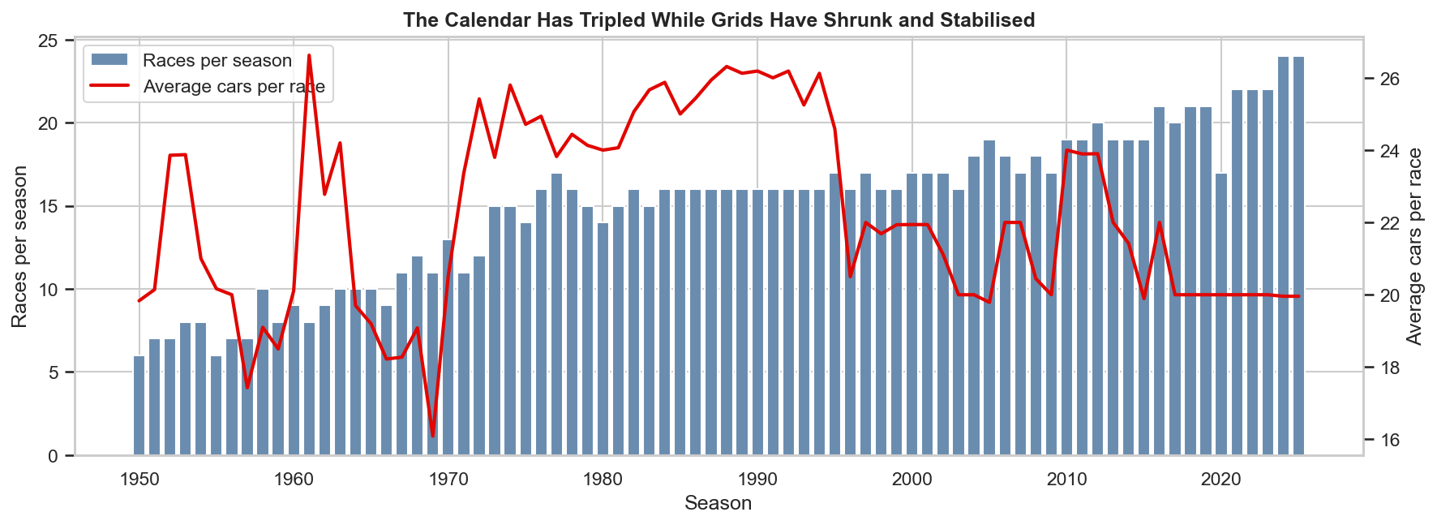
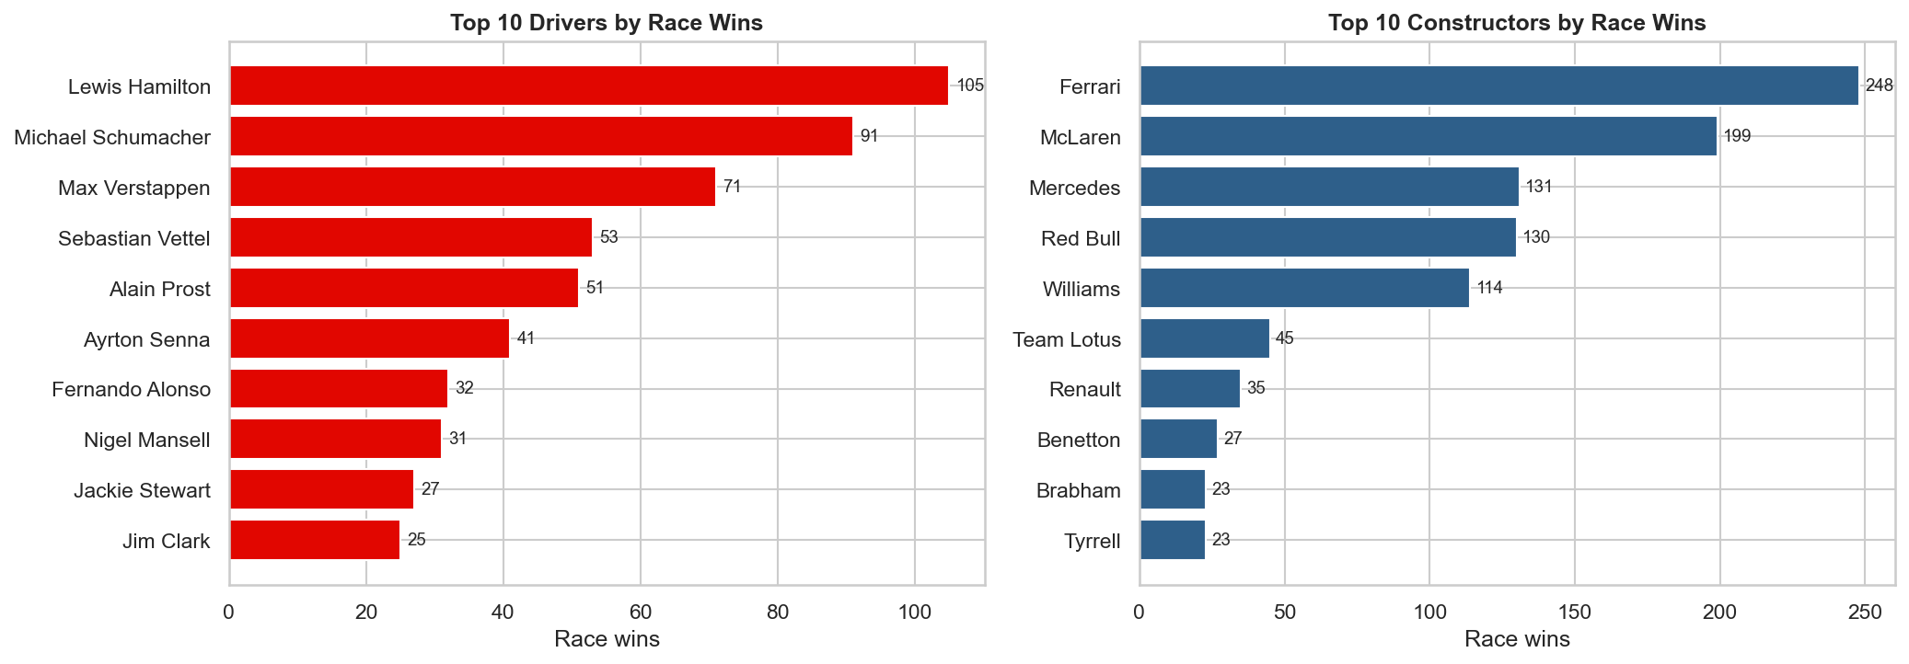
MORE RACES, FEWER WINNERS
EXPLORATORY DATA ANALYSIS
Calendar grew from 6 races (1950) to 24 (2025); grids settled at 20 cars
Success is concentrated: Hamilton 105 wins, Ferrari 248
0.8
31 → 27
Monza 75
median grid-to-finish correlation since 2000
median driver age, 1950s era vs today
most races hosted (Monaco 71, Silverstone 60)
Notes:
EDA showed three things. The calendar tripled while grids stabilised at about 20 cars, so modern seasons give far more data. Success is highly concentrated in a few drivers and teams, which we test formally in Q4. And the starting grid is the variable most strongly correlated with the finishing position, which motivates both Q1 and the regression model. Drivers are also younger now: median age fell from 31 to about 27.

Slide 6
13 HYPOTHESIS TESTS, 3 A/B TESTS
Every test: H0/H1, p-value and effect size · α = 0.05
# | Question | Test | Result
Q1 | Does grid position decide the result? | Kruskal–Wallis | Yes, ρ ≈ 0.8 since 2000
Q2 A/B | Hybrid era: does pole convert more often? | Two-proportion z | No, p = 0.35
Q3 | Is Monaco "won on Saturday"? | χ², Mann–Whitney | Only partly
Q4 | Is F1 more dominated by one team? | Kendall τ (segmented) | Yes since 1980, p = 0.009
Q5 | Car or driver: which explains results? | Nested ANOVA | Car 60%, driver 4.5%
Q6 | Have cars become more reliable? | χ², Cramér's V | Yes, finish 50% → 86%
Q7 | Are pit crews more consistent? | Spearman trend | Yes, 35% tighter
Q8 | When do drivers peak? | Bradley–Terry, LR | Age 28–30
Q9 | Is there a home advantage? | Paired t, Wilcoxon | No, p = 0.41
Q10 | Which nations produce the best drivers? | Binomial + Holm | Germany 60%, Spain 62%
Q11 A/B | Did the 2022 rules increase overtaking? | Welch t, Mann–Whitney | Yes, +13%, p = 0.023
Q12 A/B | Street circuits: more crashes? | χ², Mann–Whitney | Yes, +41% crashes
Q13 | When is the title decided? | Wilson CI, Fisher | Mid-season leader wins 74%
Notes:
We tested 13 hypotheses, each stating H0 and H1 and reporting both a p-value and an effect size. With tens of thousands of rows, tiny effects become significant, so effect size decides practical importance. The three shaded rows are A/B tests. Q11 is the headline policy test: the 2022 ground-effect rules increased position changes by 13 percent (Welch t-test p = 0.023, confirmed by Mann–Whitney, Cohen's d = 0.33, small). Q2 shows the hybrid era did not significantly change pole conversion (49% vs 54%, p = 0.35). Several popular beliefs were rejected: no home advantage, no hybrid pole premium, and Monaco's pole converts no more often than elsewhere. In Q10 the Holm correction removed two false positives, Britain and Italy.

Slide 7
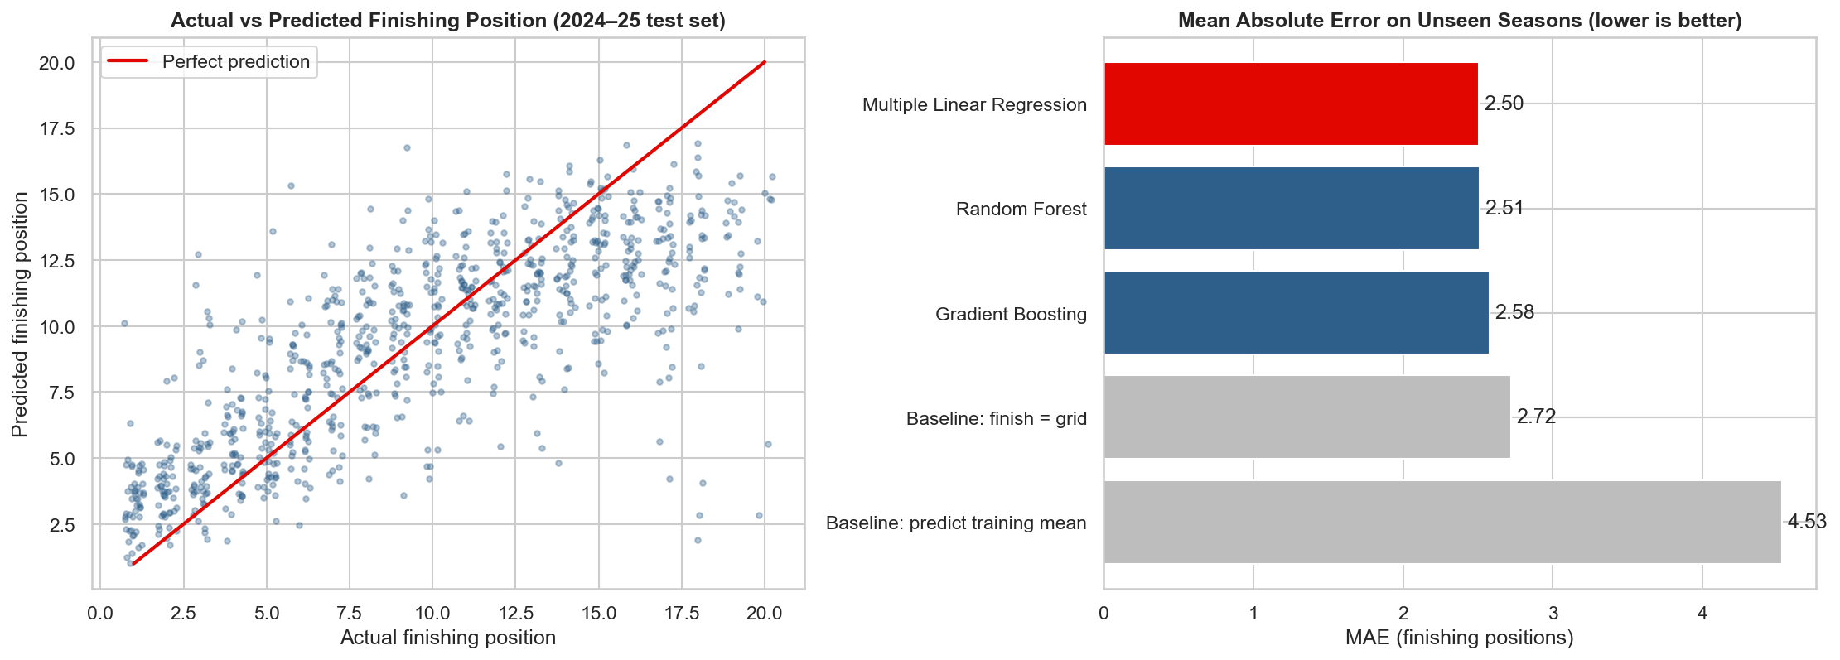
PREDICTING THE FINISH WITHIN 2.5 PLACES
ML MODEL · MULTIPLE LINEAR REGRESSION
0.60
2.50
test R²
MAE, places
−15%
= RF
RMSE vs baseline
as accurate
Why linear: numeric target, interpretable coefficients, and Random Forest adds no accuracy
Validation: trained 2014–23, tested on unseen 2024–25; no pre-race data leakage
Assumptions: VIF ≤ 3.2, race-clustered robust errors, residual checks
Notes:
We chose multiple linear regression because the target, finishing position, is numeric and the relationships are roughly linear, and because coefficients can be explained: each grid place is worth about 0.4 finishing places, and each place of team form about 0.4. Features use only pre-race information: grid, team form over the previous three races, experience, age, street circuit, home race and era. We trained on 2014 to 2023 and tested on the unseen 2024 and 2025 seasons. Test R squared is 0.60 and the average error is 2.5 places, 8 percent better than the finish-equals-grid baseline on MAE and 15 percent on RMSE. Random Forest and Gradient Boosting did not do better, so the simpler model wins. We checked all assumptions: dropped driver form because its VIF was 5.4, used race-clustered robust standard errors because drivers in the same race are not independent, and checked residuals.

Slide 8
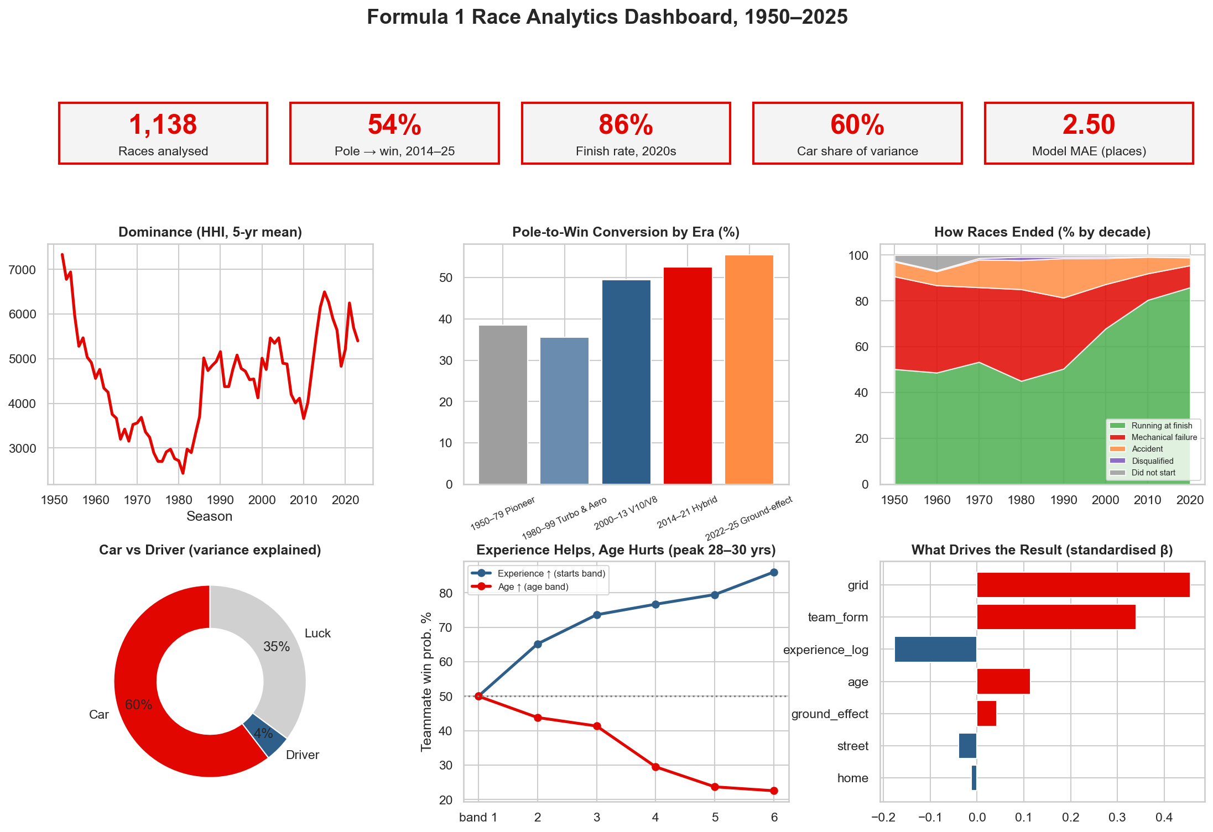
THE WHOLE STUDY ON ONE SCREEN
VISUALIZATION · PYTHON DASHBOARD
22 charts
every chart titled, axes labelled
Chart types used: bar, stacked and grouped bar, line, area, histogram, KDE, box, violin, strip, ECDF, heatmap, hexbin, lollipop, dumbbell, donut, error bars, Q–Q, residual plots, map
Interactive: Plotly season explorer and circuit world map
Power BI ready: 3 clean tables exported to CSV
Notes:
The dashboard summarises the study. Top row: five key numbers. Below: the rise of single-team dominance since 1980, pole conversion by era, the reliability revolution, the car-versus-driver split, the experience and age effects, and what drives the regression prediction. Across the notebook there are 22 charts covering about 20 chart types, plus an interactive Plotly season explorer and a world map of circuits. The cleaned data is also exported for Power BI or Tableau.

Slide 9
A RACE IS MOSTLY DECIDED BEFORE IT STARTS
KEY FINDINGS AND INTERPRETATION
13.6×
~50%
+13%
The car explains far more than the driver (60% vs 4.5% of variance)
Pole wins half of races, unchanged by the hybrid era (p = 0.35)
2022 rules raised overtaking: significant, small, fading after 2023
2.1
28–30
No
effective winning teams in the 2020s: dominance rising since 1980
peak age: experience helps, age hurts, as separate forces
home advantage (p = 0.41): a belief rejected by the data
Notes:
Six headline findings. The car explains 13.6 times more of the results than the driver. Pole position wins about half of races, and the hybrid era did not change that. The 2022 regulations increased overtaking by 13 percent, a significant but small effect that faded after 2023. Dominance has been rising since 1980, with only about two effective winning teams in the 2020s. Drivers peak at 28 to 30 because experience helps while age hurts. And there is no home advantage. Also worth mentioning: reliability rose from 50 to 86 percent finishes, and street circuits carry 41 percent more crash risk.

Slide 10
CAR AND QUALIFYING DECIDE; RACE DAY ADDS A THIRD
CONCLUSION AND LIMITATIONS
CONCLUSION
LIMITATIONS
Results are set mostly before the lights go out: by the car a team builds and where it qualifies.
Observational data: era A/B tests show association, not proven cause
Top drivers join top teams, so the car's 60% is an upper bound
No weather, safety-car or tyre data in the source
Pit data only from 2011, and total pit-lane time only
Small samples for single circuits and some nationalities
Tests confirmed car dominance, the reliability revolution and rising dominance, and rejected home advantage and a hybrid-era pole premium.
The regression predicts the finish within 2.5 places; about 35% of variation stays unpredictable.
Notes:
Our conclusion: a Formula 1 result is decided mostly before the race begins, by the car and the qualifying position, while race day adds roughly a third of unpredictable variation. We are honest about limitations: this is observational data, so era comparisons are natural experiments rather than controlled ones; car and driver quality are partly confounded; and the source lacks weather, safety-car and tyre information, which would explain part of the remaining variance.

Slide 11






FROM ANALYSIS TO A LIVE RACE PREDICTOR
FUTURE ENHANCEMENT
RICHER DATA
LAP-TIME PACE
RANKING MODELS
Weather, safety cars and tyres via the FastF1 telemetry library
Gap to pole in seconds instead of grid rank as the pace measure
Ordered logit plus a retirement-risk classifier for a full race simulator
ALL-TIME RATINGS
CAUSAL METHODS
LIVE FORECASTS
Extend the teammate model into an era-adjusted, Elo-style driver rating
Difference-in-differences to measure regulation effects more rigorously
Update predictions after each qualifying session, with a Power BI dashboard
Notes:
Next steps would turn the study into a live tool. Add weather, safety-car and tyre data from the FastF1 library. Use qualifying lap-time gaps instead of grid rank. Move to ranking models plus a retirement-risk classifier to simulate whole races. Build an all-time, era-adjusted driver rating from the teammate model. Use causal methods such as difference-in-differences for regulation effects. And publish live forecasts after every qualifying session.

Slide 12
THANK YOU
REFERENCES AND DATASET SOURCE
SOURCES
Dataset: Jolpica F1 open database (successor to the Ergast API), github.com/jolpica/jolpica-f1
FIA Formula One Technical and Sporting Regulations (2014 power units; 2022 technical rules)
U.S. DOJ and FTC, Merger Guidelines (2023): Herfindahl–Hirschman Index thresholds
Bradley, R. A. and Terry, M. E. (1952). Rank analysis of incomplete block designs. Biometrika, 39, 324–345
Cohen, J. (1988). Statistical Power Analysis for the Behavioral Sciences, 2nd ed.
Seabold and Perktold (2010), statsmodels; Pedregosa et al. (2011), scikit-learn, JMLR 12
Questions welcome
Notes:
Our data comes from the Jolpica F1 open database. Statistical methods follow standard references: the Herfindahl–Hirschman Index from competition regulation, the Bradley–Terry model for paired comparisons, and Cohen's effect-size conventions. Analysis was done in Python with pandas, statsmodels and scikit-learn. Thank you; we are happy to take questions.

